Slide 1
The Endocrine System
Objectives:
Identify the contributions of the endocrine system to homeostasis
Discuss the chemical composition of hormones and the mechanisms of hormone action
Summarize the site of production, regulation, and effects of the hormones of the pituitary, thyroid, parathyroid, adrenal, and pineal glands
Discuss several common diseases associated with endocrine system dysfunction

Slide 2
What is the system?
Made up of glands that produce and secrete hormones, chemical messengers
Regulation of growth, metabolism, sexual development
Responses to stress and injury
Maintains homeostasis
Glands are found in different areas of the body.

Slide 3
BIG IDEA:
HORMONES are chemical MESSENGERS that act on target cells

Slide 4
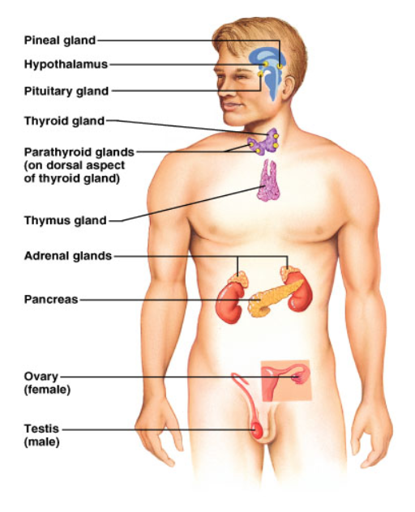
Major Structures of the Endocrine System
Pineal Hypothalamus Pituitary | Brain
Thyroid Parathyroid | Throat
Thymus | Above heart
Adrenal | Above kidneys
Pancreas | Under stomach
Ovary / Teste | Lower abdomen / Groin

Slide 5
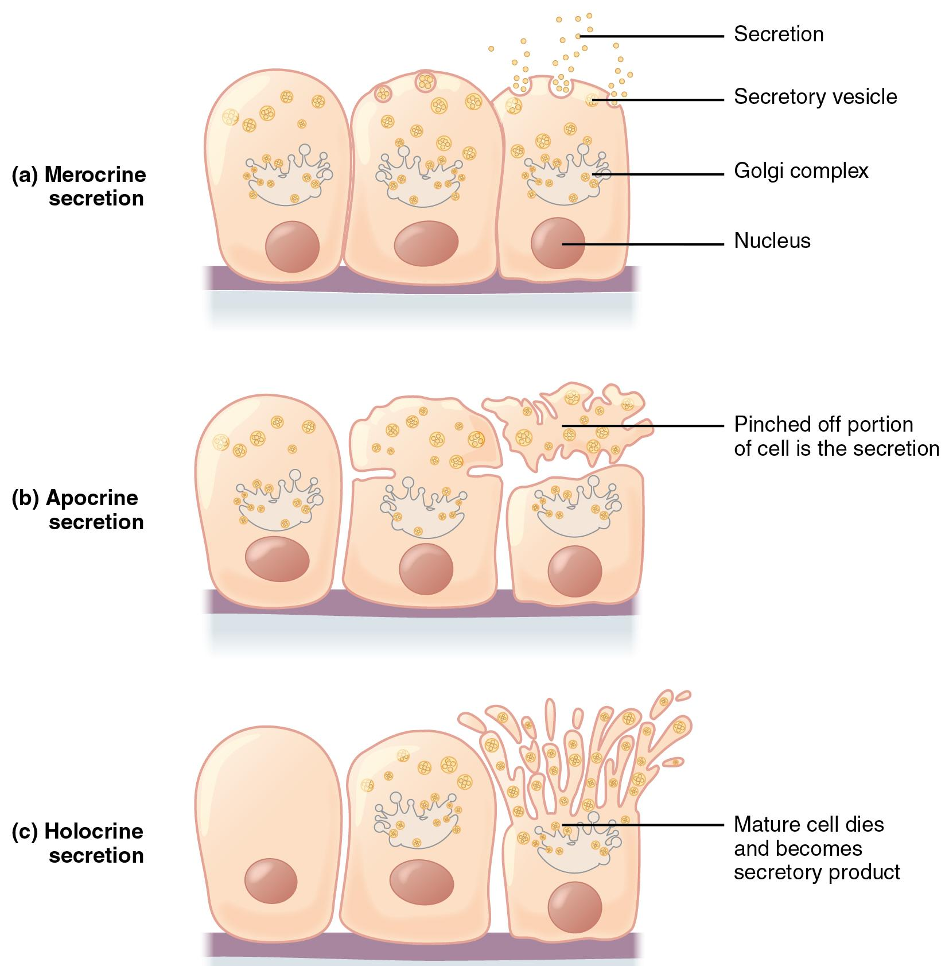
Endocrine – secretions inside the body
Exocrine – secretions outside the body (sweat)
Saliva
Breast Milk
Sweat

Slide 6
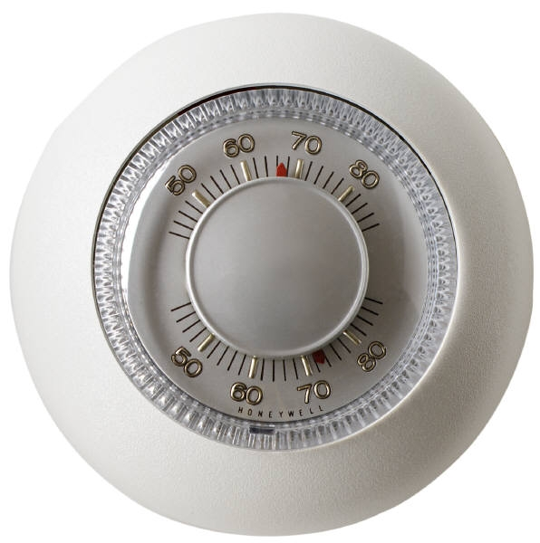
Control of Hormones
Negative feedback system
When the levels go above or below a SET POINT, the endocrine system secretes hormones to lower or raise the level.
Think of it like the thermostat of your house.

Slide 7
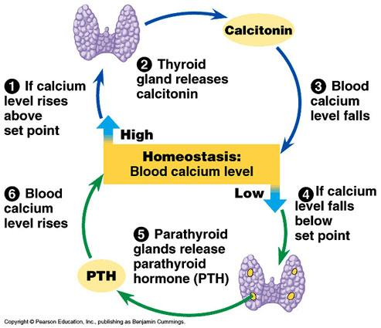
Example of Negative Feedback:
Calcium regulation by the thyroid parathyroid

Slide 8
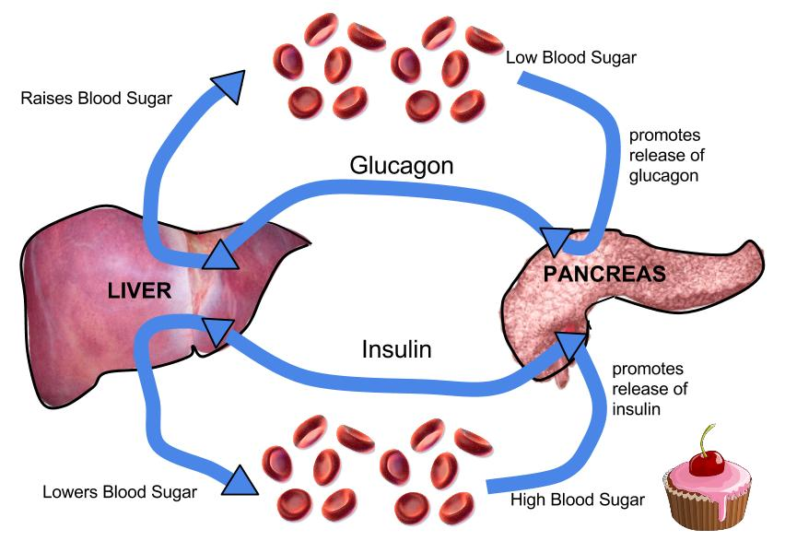
Example of Negative Feedback
Glucose levels rise - insulin is produced to cause sugar to be taken up by the cells (and out of the blood)

Slide 9
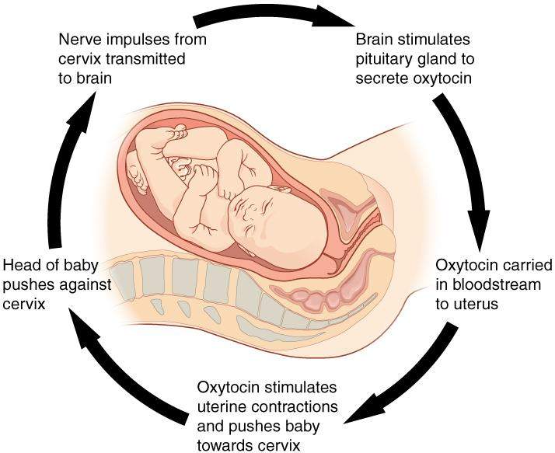
Positive Feedback System

Slide 10
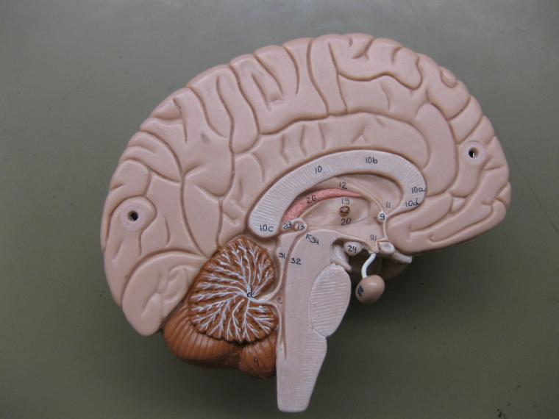
11.5 Pituitary Gland
22 = Thalamus
24 = Hypothalamus

Slide 11
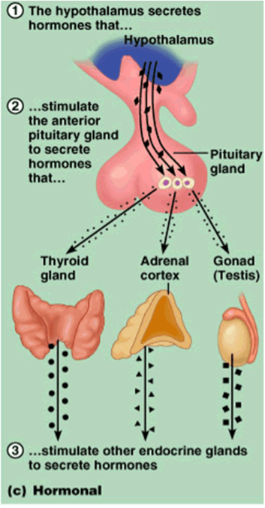
Hormone Control
The pituitary is often called the “master gland”
because it controls all of the other glands.
Its actions are controlled by the hypothalamus in the brain.

Slide 12
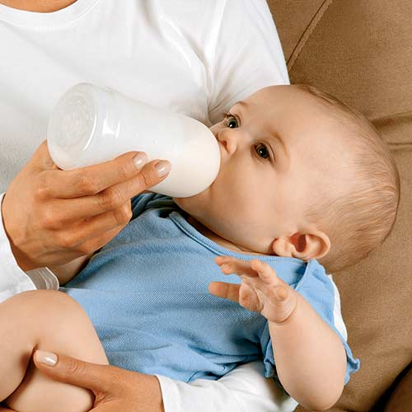
Anterior Pituitary Hormones
Prolactin or PRL - PRL stimulates milk production from a woman's breasts after childbirth and can affect sex hormone levels from the ovaries in women and the testes in men.
Risperdal (ADHD drug) can increase production of a hormone called prolactin, which stimulates breast growth, or gynecomastia
http://www.banderasnews.com/0905/hb-risperdal.htm

Slide 13
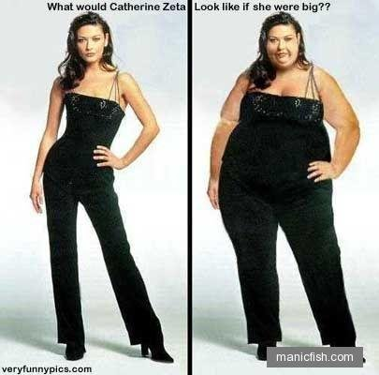
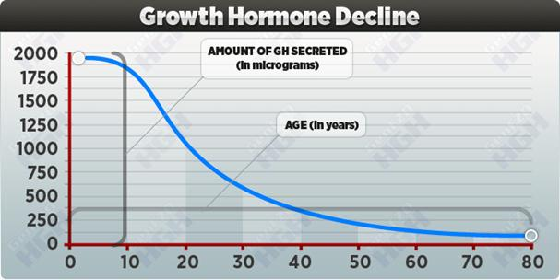
Growth hormone or GH - GH stimulates growth in childhood and is important for maintaining a healthy body composition. In adults it is also important for maintaining muscle mass and bone mass.
It can affect fat distribution in the body.

Slide 14
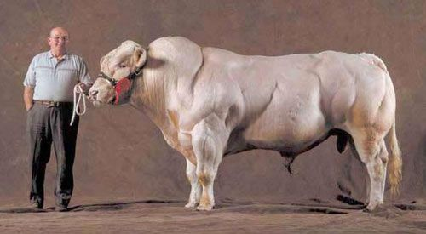
That’s a bull of the Belgian Blue breed, which has a genetic anomaly that suppresses the production of a hormone called myostatin that inhibits muscle growth – hence the ‘double muscling’ seen above.
Myostatin inhibitor drugs are being developed with the intent of treating muscle-wasting diseases like muscular dystrophy in humans.

Slide 15
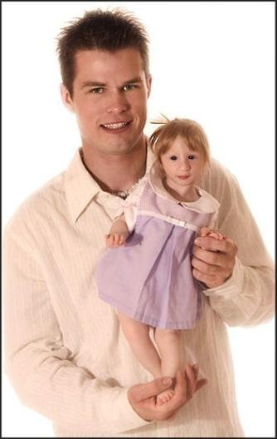
Problems with the pituitary gland can result in Dwarfism
Primordial Dwarfism

Slide 16
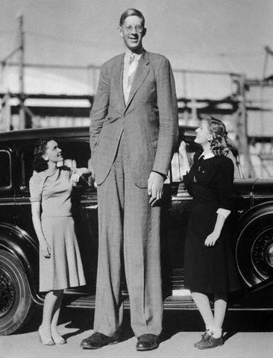
Or a person can grow too much. These are pictures of the man known as “The Alton Giant”, Robert Wadlow. Robert was 8’11”

Slide 17
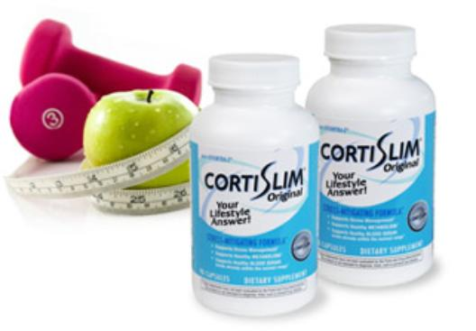
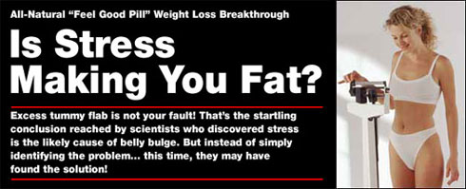
Adrenocorticotropin or ACTH - ACTH stimulates production of cortisol by the adrenal glands.
Cortisol, a so-called "stress hormone," is vital to survival. It helps maintain blood pressure and blood glucose levels.
Many diet aids claim that they block cortisol levels. Cortisol from stress may lead to fat deposits in the belly.

Slide 18
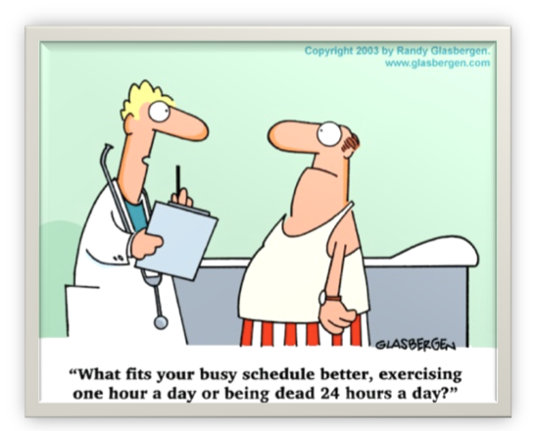
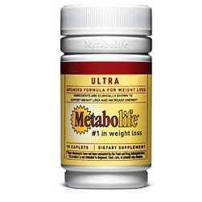
Thyroid-stimulating hormone or TSH - TSH stimulates the thyroid gland to make thyroid hormones, which, in turn, control (regulate) the body's metabolism, energy, growth and development, and nervous system activity.

Slide 19
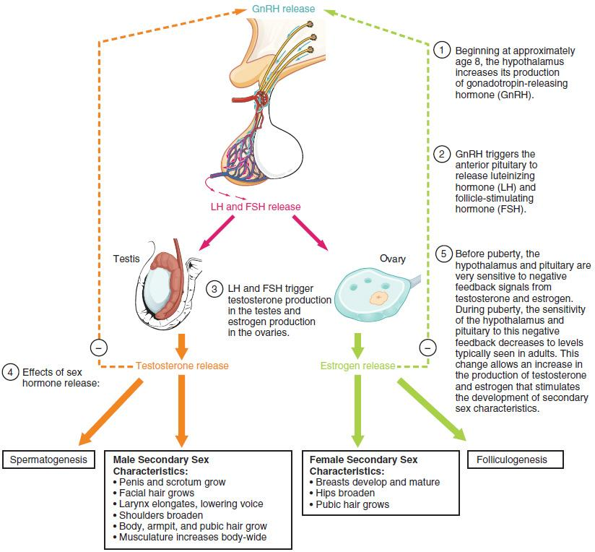
Luteinizing hormone or LH - LH regulates testosterone in men and estrogen in women. (gonadotropin)

Slide 20
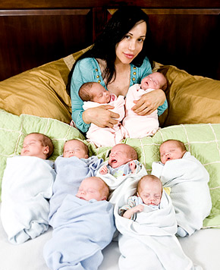
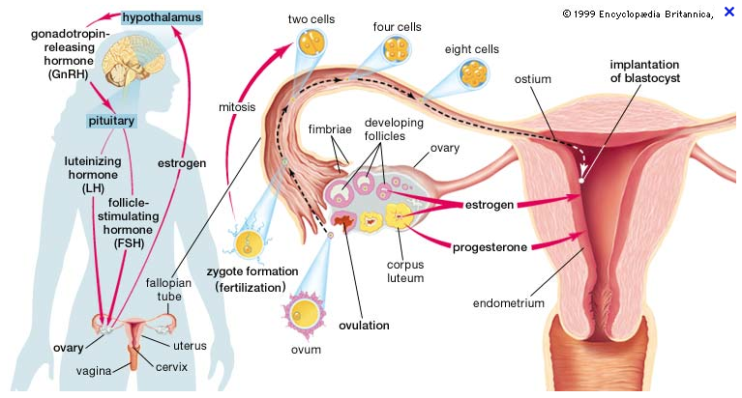
Follicle-stimulating hormone or FSH - FSH promotes sperm production in men and stimulates the ovaries to release eggs (ovulate) in women. LH and FSH work together to allow normal function of the ovaries or testes. (gonadotropin)

Slide 21
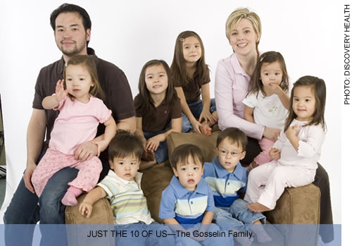

Slide 22
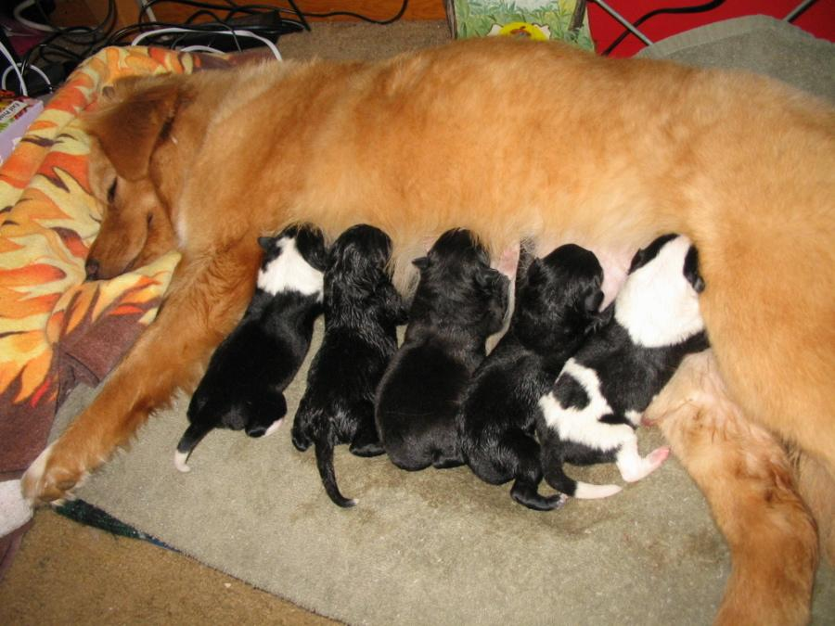
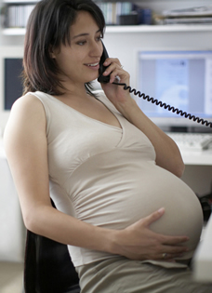
Posterior Pituitary Hormones
Oxytocin - Oxytocin causes milk letdown in nursing mothers and contractions during childbirth.

Slide 23
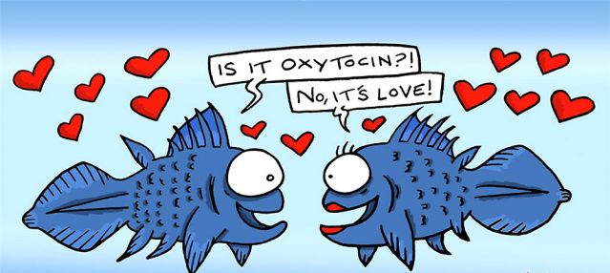
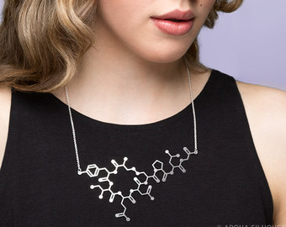
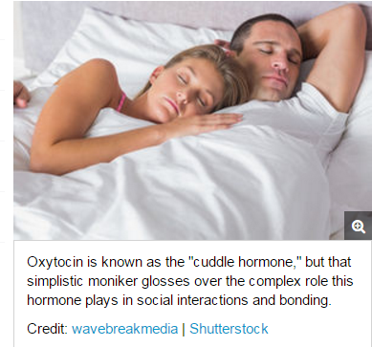

Slide 24
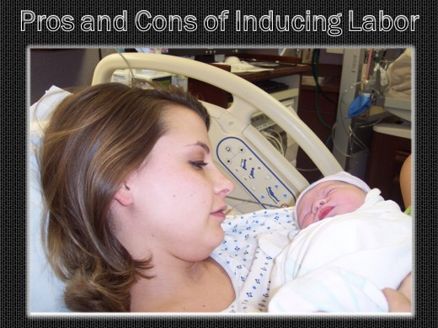
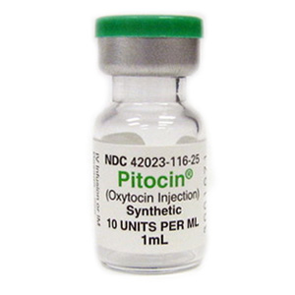
Pitocin is another very controversial topic in childbearing today.
Oxytocin is a natural hormone produced by a woman's body that cause uterine contractions. Pitocin is the synthetic form of oxytocin.
Pitocin is generally used in two ways: 1) to induce labor, and 2) to augment (speed up) labor.

Slide 25
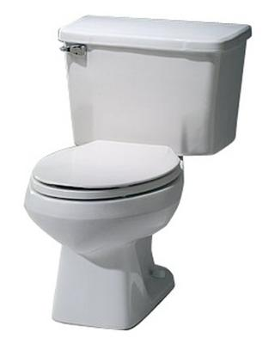
Antidiuretic hormone or ADH - ADH, also called vasopressin, is stored in the back part of the pituitary gland and regulates water balance.
Too much urination can lead to dehydration. When the body is dehydrated, ADH will cause the kidneys to conserve water.

Slide 26
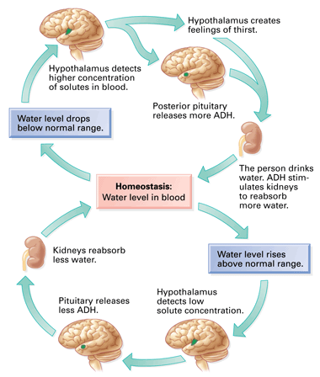
Why do you feel thirsty?
Is this positive or negative feedback?

Slide 27
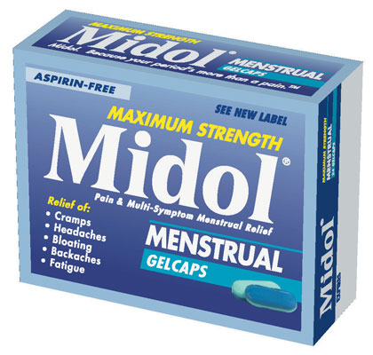
Diuretics – increase urine production
Many common foods and drinks contain chemicals that are diuretics (alcohol)
Midol relieves symptoms of bloating because it contains a diuretic that will make you urinate more
Active Ingredients: (in each caplet): Acetaminophen (500 mg) (Pain Reliever), Caffeine (60mg) (Diuretic, Stimulant), Pyrilamine Maleate (15 mg) (Diuretic) Inactive Ingredients: Carnauba Wax, Croscarmellose Sodium, FD&C Blue 2, Hypromellose, Magnesium Stearate, Microcrystalline Cellulose, Pregelatinized Starch, Propylene Glycol, Shellac, Titanium Dioxide, Triacetin

Slide 28
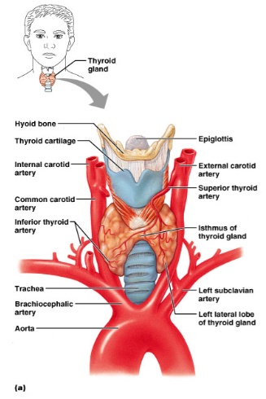
THYROID GLAND
The thyroid hormones control your metabolism, which is the body's ability to break down food and store it as energy and release of energy
TED-Ed Video on the Thyroid

Slide 29
THYROID HORMONES
Thyroxin (T4) & Tri-iodothyronine (T3) - both increase the rate at which cells release energy from carbohydrates
Calcitonin – regulates the blood concentration of calcium
BMR – basal metabolic rate : how many calories the body must consume to maintain life
BMR Calculator

Slide 30
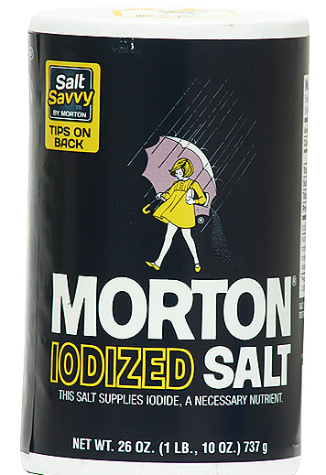
Problems with the Thyroid
Iodine is essential for the formation of thyroxine.
Lack of iodine causes a swelling of the thyroid → GOITER.
Iodine is only found in seafood, so if salt wasn’t iodized, a lot of people wouldn’t get enough iodine, and there would be a lot of goiters.

Slide 31
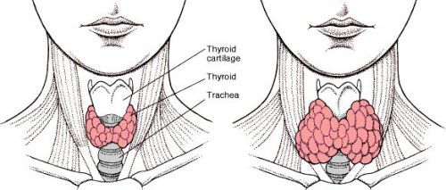
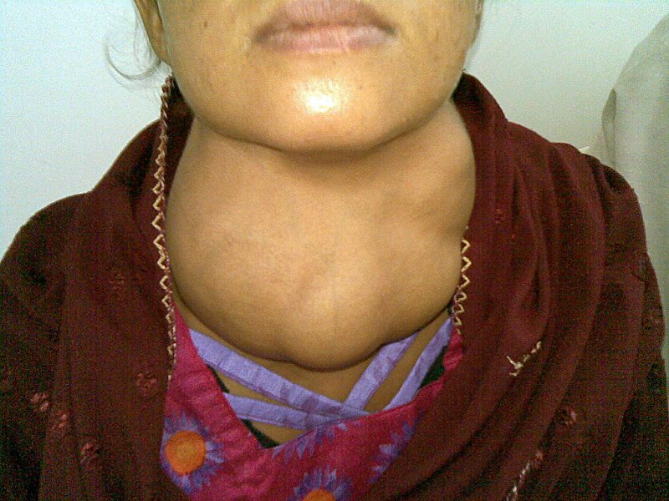
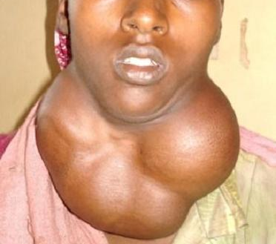
Goiter

Slide 32
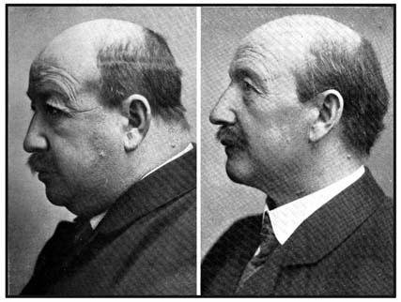
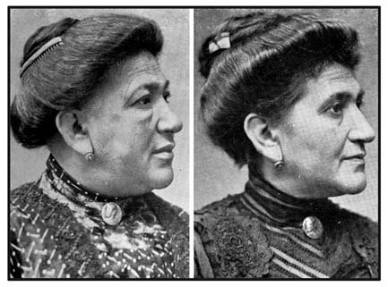
Hypothyroidism Before and After Treatment

Slide 33
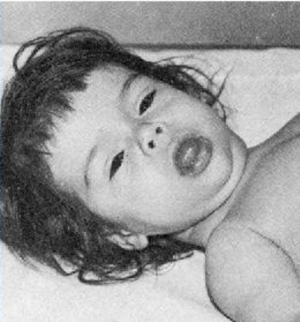
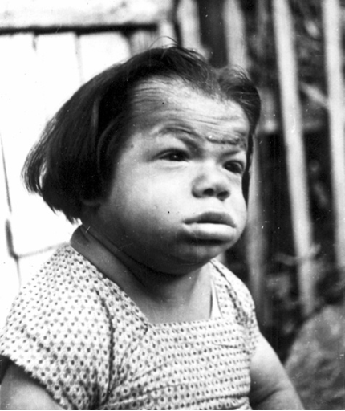
Cretinism (hypothyroidism in infants)

Slide 34
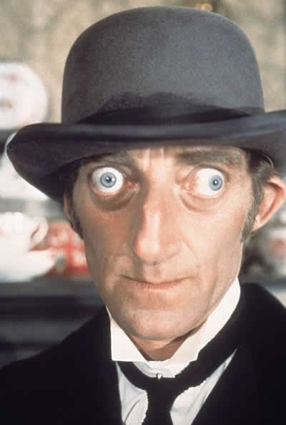
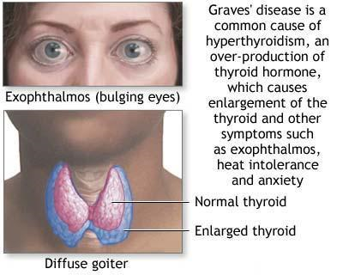
Hyperthyroidism (Grave’s Disease)

Slide 35
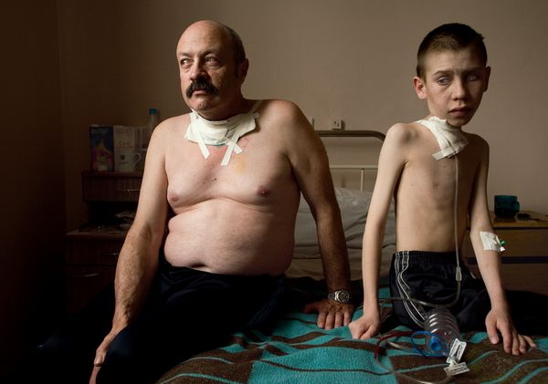
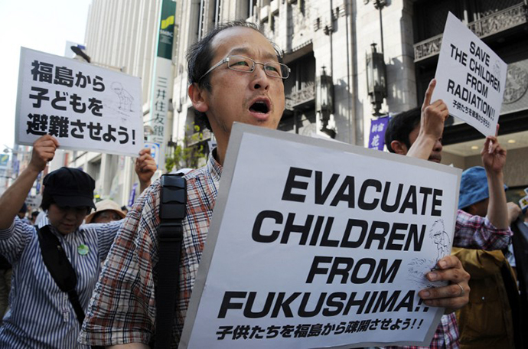
Exposure to radioactive iodine in childhood is also believed to be associated with thyroid cancer. Following the Chernobyl nuclear power plant explosion, there was an increase in thyroid cancer in children.

Slide 36
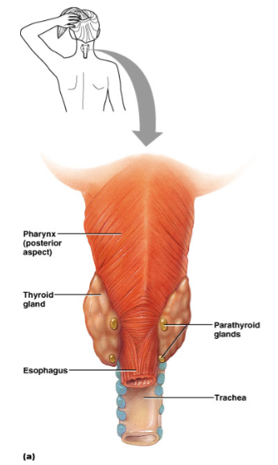
Parathyroid Glands
Located behind the thyroid, four tiny glands Parathyroid Hormone (PTH) - takes calcium from the bones to make it available in the blood

Slide 37
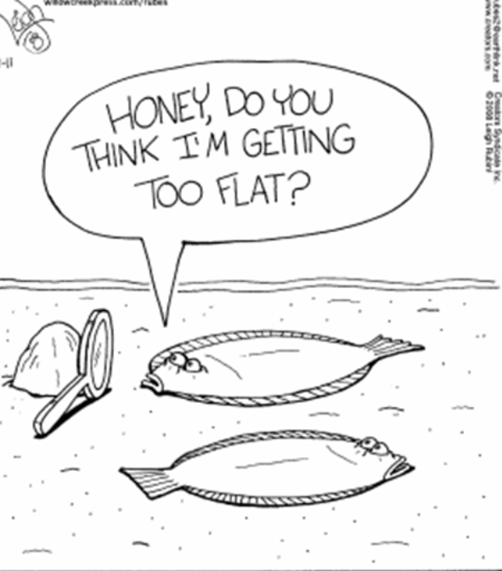
Removal of a mass and thyroid gland:
https://www.youtube.com/watch?v=zLaaIYtSXnk

Slide 38
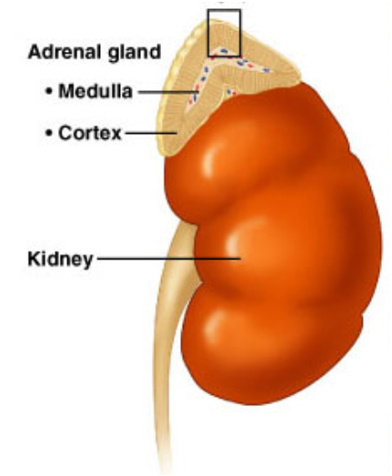
Adrenal Glands
Located at the top of the kidneys
Adrenal Cortex - outer area
Adrenal Medulla - inner area
Adrenal Glands produce adrenaline

Slide 39
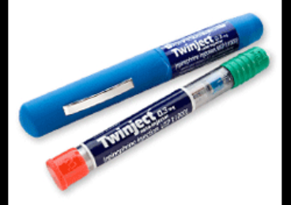
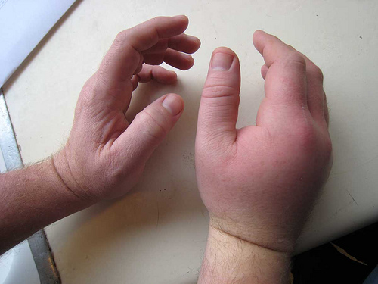
Adrenal Medulla
Epinephrine & Norepinephrine – increased heart rate, breathing rate, elevated blood pressure (fight or flight, response to stress)
People with severe life threatening allergies often carry injectors

Slide 40
EpiPen, an epinephine auto-injector used to treat allergy reactions that has seen its price rise from $57 in 2007 to about $500
The cost to manufacture the drug is about $1.00 (estimated)
Should the government enact laws to control the prices of drugs?

Slide 41
Adrenal Cortex
Aldosterone – helps kidneys conserve sodium and excrete potassium, maintaining blood pressure
Cortisol – keeps blood glucose levels stable, response to stress
Adrenal Sex Hormones - androgens (male) and estrogens (female)

Slide 42
Adrenal Gland Disorders
Cushing’s Disease
Hyperadrenocorticism
Increased thirst and urination
Increased hunger
Increased panting
Pot-bellied abdomen
Obesity
Loss of hair
https://www.vetdepot.com/article-images/cushings-disease.gif
Cushing's syndrome happens when the adrenal glands makes too much cortisol.
Notes:
Cushings can be caused by a benign pituitary tumor (most common), a tumor on the adrenal glands, or overuse of steroids (often used to treat allergies or autoimmune disease)

Slide 43
This is Suki
In 2015, she was diagnosed was diagnosed with Cushing’s Disease
One month later, she was diagnosed with diabetes.
While her condition is managed with medication, she is now permanently blind.
Notes:
All of her problems are associated with the endocrine system

Slide 44
Addison’s disease
Hyposecretion of cortisol
Low blood pressure results
Increased pigmentation

Slide 45
Pancreas
The pancreas is a large gland behind the stomach that helps the body to maintain healthy blood sugar (glucose) levels.
Contains islands of cells called the Islets of Langerhans which secrete glucagon and insulin

Slide 46
Glucagon – stimulates the liver to break down glycogen, raises blood sugar
Insulin – decreases blood sugar concentrations, affects the uptake of glucose by cells
*Both hormones work together to maintain a balance in the blood sugar

Slide 48
Diabetes
Diabetes Mellitus – results from an insulin deficiency, blood sugar rises (hyperglycemia) and excess is excreted in the urine.
Type I - insulin dependent diabetes mellitus or juvenile onset diabetes, often caused by inherited immune disorder that destroys pancreatic cells

Slide 49
Type II – mature onset diabetes (usually after the age of 40), often individuals are overweight, can be controlled with diet and exercise
Blood sugar test, device pricks the finger and measures the amount of sugar in the blood

Slide 50
Injection of insulin will lower the blood sugar levels
Hypoglycemia can occur if levels become too low, can be cured with direct injection of glucose or with eating something high in sugar. This is why diabetics often have candy.

Slide 51
Diabetes Insipidus
Symptoms Excessive thirst ---May be intense or uncontrollable ----May involve a craving for ice water Excessive urine volume
Diabetes insipidus (DI) is an uncommon condition that occurs when the kidneys are unable to conserve water as they perform their function of filtering blood.
The amount of water conserved is controlled by antidiuretic hormone (ADH), also called vasopressin.
ADH is a hormone produced in a region of the brain called the hypothalamus.

Slide 52
Gestational Diabetes
Pregnancy hormones can block insulin from doing its job. When this happens, glucose levels may increase in a pregnant woman's blood.
Gestational diabetes usually starts halfway through the pregnancy. All pregnant women should receive an oral glucose tolerance test between the 24th and 28th week of pregnancy to screen for the condition.

Slide 53
Diabetic neuropathies are a family of nerve disorders caused by diabetes. People with diabetes can develop nerve damage throughout the body. Symptoms include pain, tingling, or numbness-loss of feeling-in the hands, arms, feet, and legs. This can result in wounds that are slow to heal.

Slide 54
Other Endocrine Glands
Pineal Gland – located between the cerebral hemispheres,
secretes melatonin, maintains Circadian rhythms (light and dark activity)

Slide 55
Can you find the hypothalamus? Pituitary?

Slide 56
Thymus Gland – large in young children, gradually shrinks with age, secretes thymosins, important to immune function

Slide 57
Reproductive Glands – testes and ovaries – testosterone, progesterone, estrogen
GONADOTROPINS - include any hormone that affect the gonads
Notes:
Image represents fetal condition, androgens will cause the development of a penis and the testes to drop into the scrotal sac

Slide 58
Steroids
Anabolic steroids are artificially produced hormones that are the same as, or similar to, androgens, the male-type sex hormones in the body. There are more than 100 variations of anabolic steroids. The most powerful androgen is testosterone.

